Slide 1
AUTOIT
GROUP 18
Automation Testing for Desktop App

Slide 2
TABLE OF CONTENTS
01.
02.
03.
Setup Instructions
Introduction
Main Functions
04.
05.
06.
Demo
Pros & Cons
Question
About AutoIT.
What AutoIT can do?
It’s just how to download and install it.
How does AutoIt work?
Everything comes at a price.
Anything feel free to ask?

Slide 3
1.
Introduction
Somethings you need to know about AutoIT

Slide 4
WHAT IS AutoIT?
Free scripting language like BASIC
Automates Windows tasks and GUI interactions

Slide 5
Why use AutoIT?
Simplifies automation of repetitive tasks
Ideal for software testing and utility creation

Slide 6
When to use AutoIT?
Automate daily Windows tasks efficiently
Best for GUI testing and creating small tools

Slide 7
Where to use AutoIT?
Primarily in Windows environments
Applicable in businesses, software development, and personal use

Slide 8
Who uses AutoIT?
System administrators and software testers
Developers and individual users

Slide 9
How does AutoIT works?
Step 1
Step 2
Scripts written in simple syntax
Executes tasks via simulated keystrokes and mouse movements

Slide 10
2.
Main Functions
What can AutoIT do?

Slide 11
Main functions AutoIT
01.
02.
03.
Automation
Scripting
Control
Automates Windows tasks and GUI interactions.
Writes and executes scripts.
Manages user interface and applications.

Slide 12
Main functions AutoIT
Automation: Automates repetitive tasks on Windows efficiently.
Reduces manual effort and saves time
Handles tasks like file copying and complex GUI interactions

Slide 13
Main functions AutoIT
Scripting: Provides a simple, easy-to-learn scripting language.
Writes commands to control program behavior
Simulates keyboard actions and processes complex data

Slide 14
Main functions AutoIT
Control: Allows interaction with GUI elements and applications.
Automates navigation, data input, and application interactions accurately and consistently

Slide 15
3.
Setup
Instructions
Download, run installer, and follow instructions

Slide 16
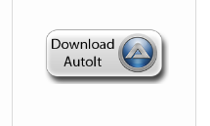
Download Installer
Visit the AutoIt website (https://www.autoitscript.com/site/autoit/downloads/) and download the installer.

Slide 17
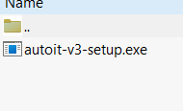
Run Installer
Open the downloaded file and follow the on-screen prompts.

Slide 18
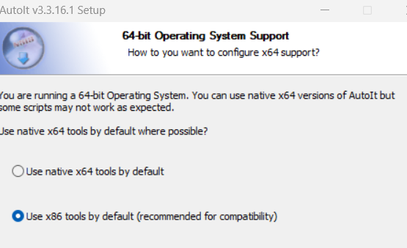
Select Components
Open the downloaded file and follow the on-screen prompts.

Slide 19
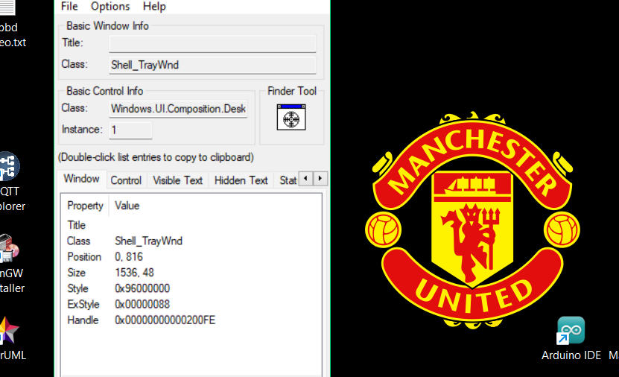
Finish!
Finish the setup and launch AutoIt from your start menu.

Slide 20
4.
Demo
It’s Demo Time!!!

Slide 21
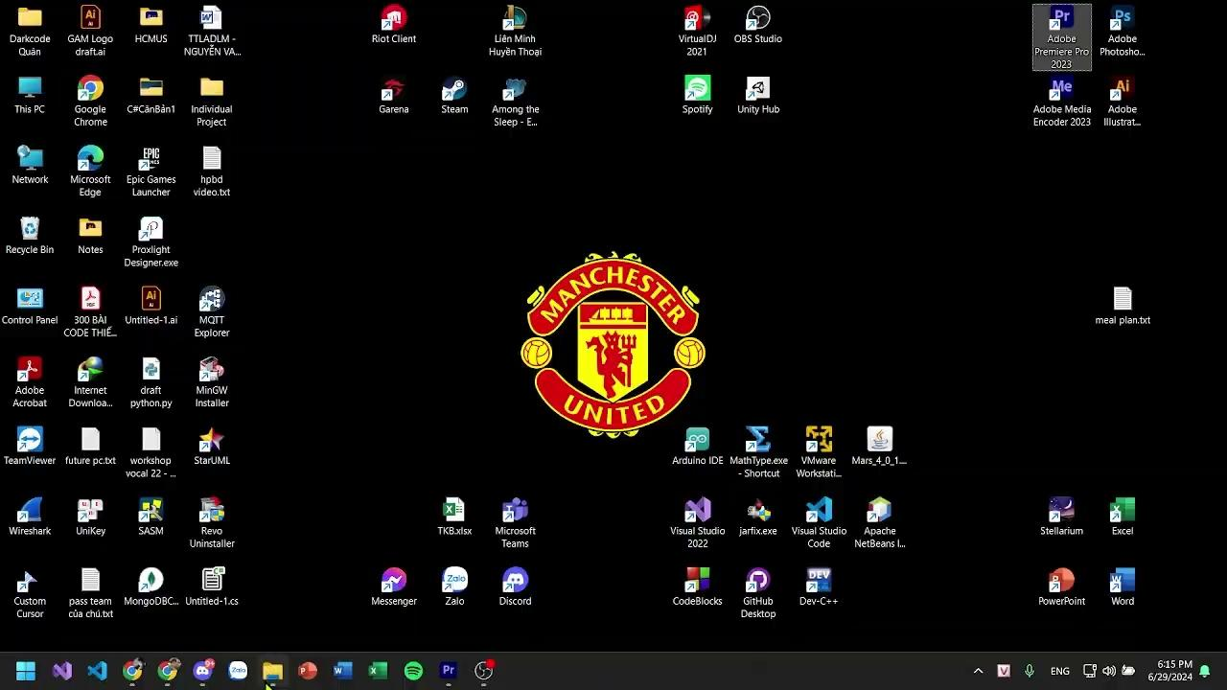
Demo

Slide 22
5.
Pros & Cons
Everything comes at a price.

Slide 23
Pros & Cons AutoIT
Ease of Use
Automation
Integration
Support
Simple syntax and comprehensive documentation.
Ideal for automating repetitive tasks and testing GUI applications.
Integration with other scripting languages and tools.
Active community providing resources, scripts, and support.

Slide 24
Pros & Cons AutoIT
Dependency
Security
Performance
Complexity
Limited support for non-Windows platforms.
Potential security risks due to its powerful automation capabilities.
Scripts can sometimes be slower compared to compiled languages.
Advanced features may require deeper understanding.

Slide 25
6.
Question
You better not asking :>

Slide 26
References
https://www.autoitscript.com/forum/
https://www.autoitscript.com/autoit3/docs/tutorials/notepad/notepad.htm
https://www.autoitscript.com/site/autoit/downloads/
https://testsigma.com/tools/desktop-automation-tools/
https://testguild.com/automation-tools-desktop/

Slide 27
Slide Editor : Định Quân
Presenter : Định Quân
Tester : (not) Định Quân
Video Editor : (also not) Định Quân
Script Writer : a random guy from nowhere
***
Định Quân - Group 18 - 20127293

Slide 28
THANKS!
Please keep this slide for attribution

